Slide 1
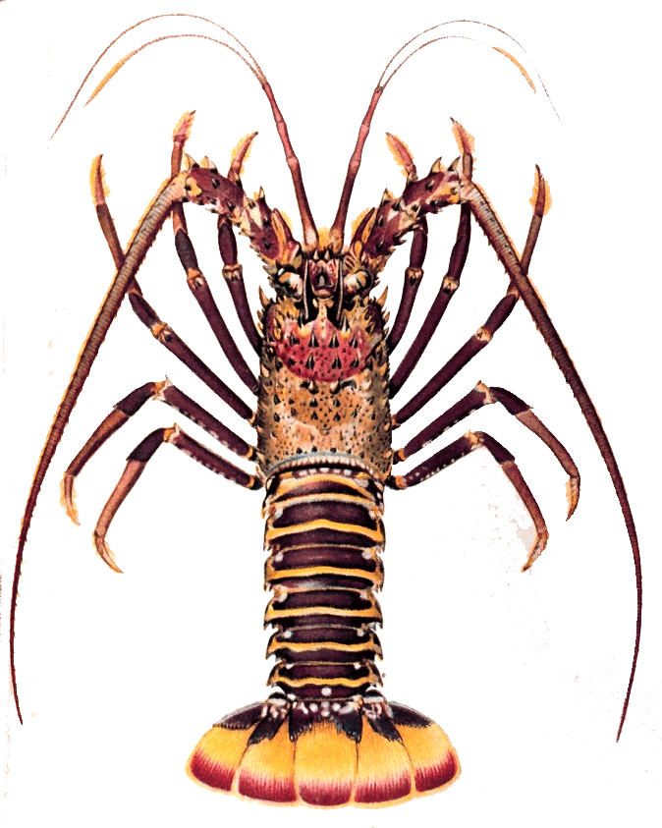
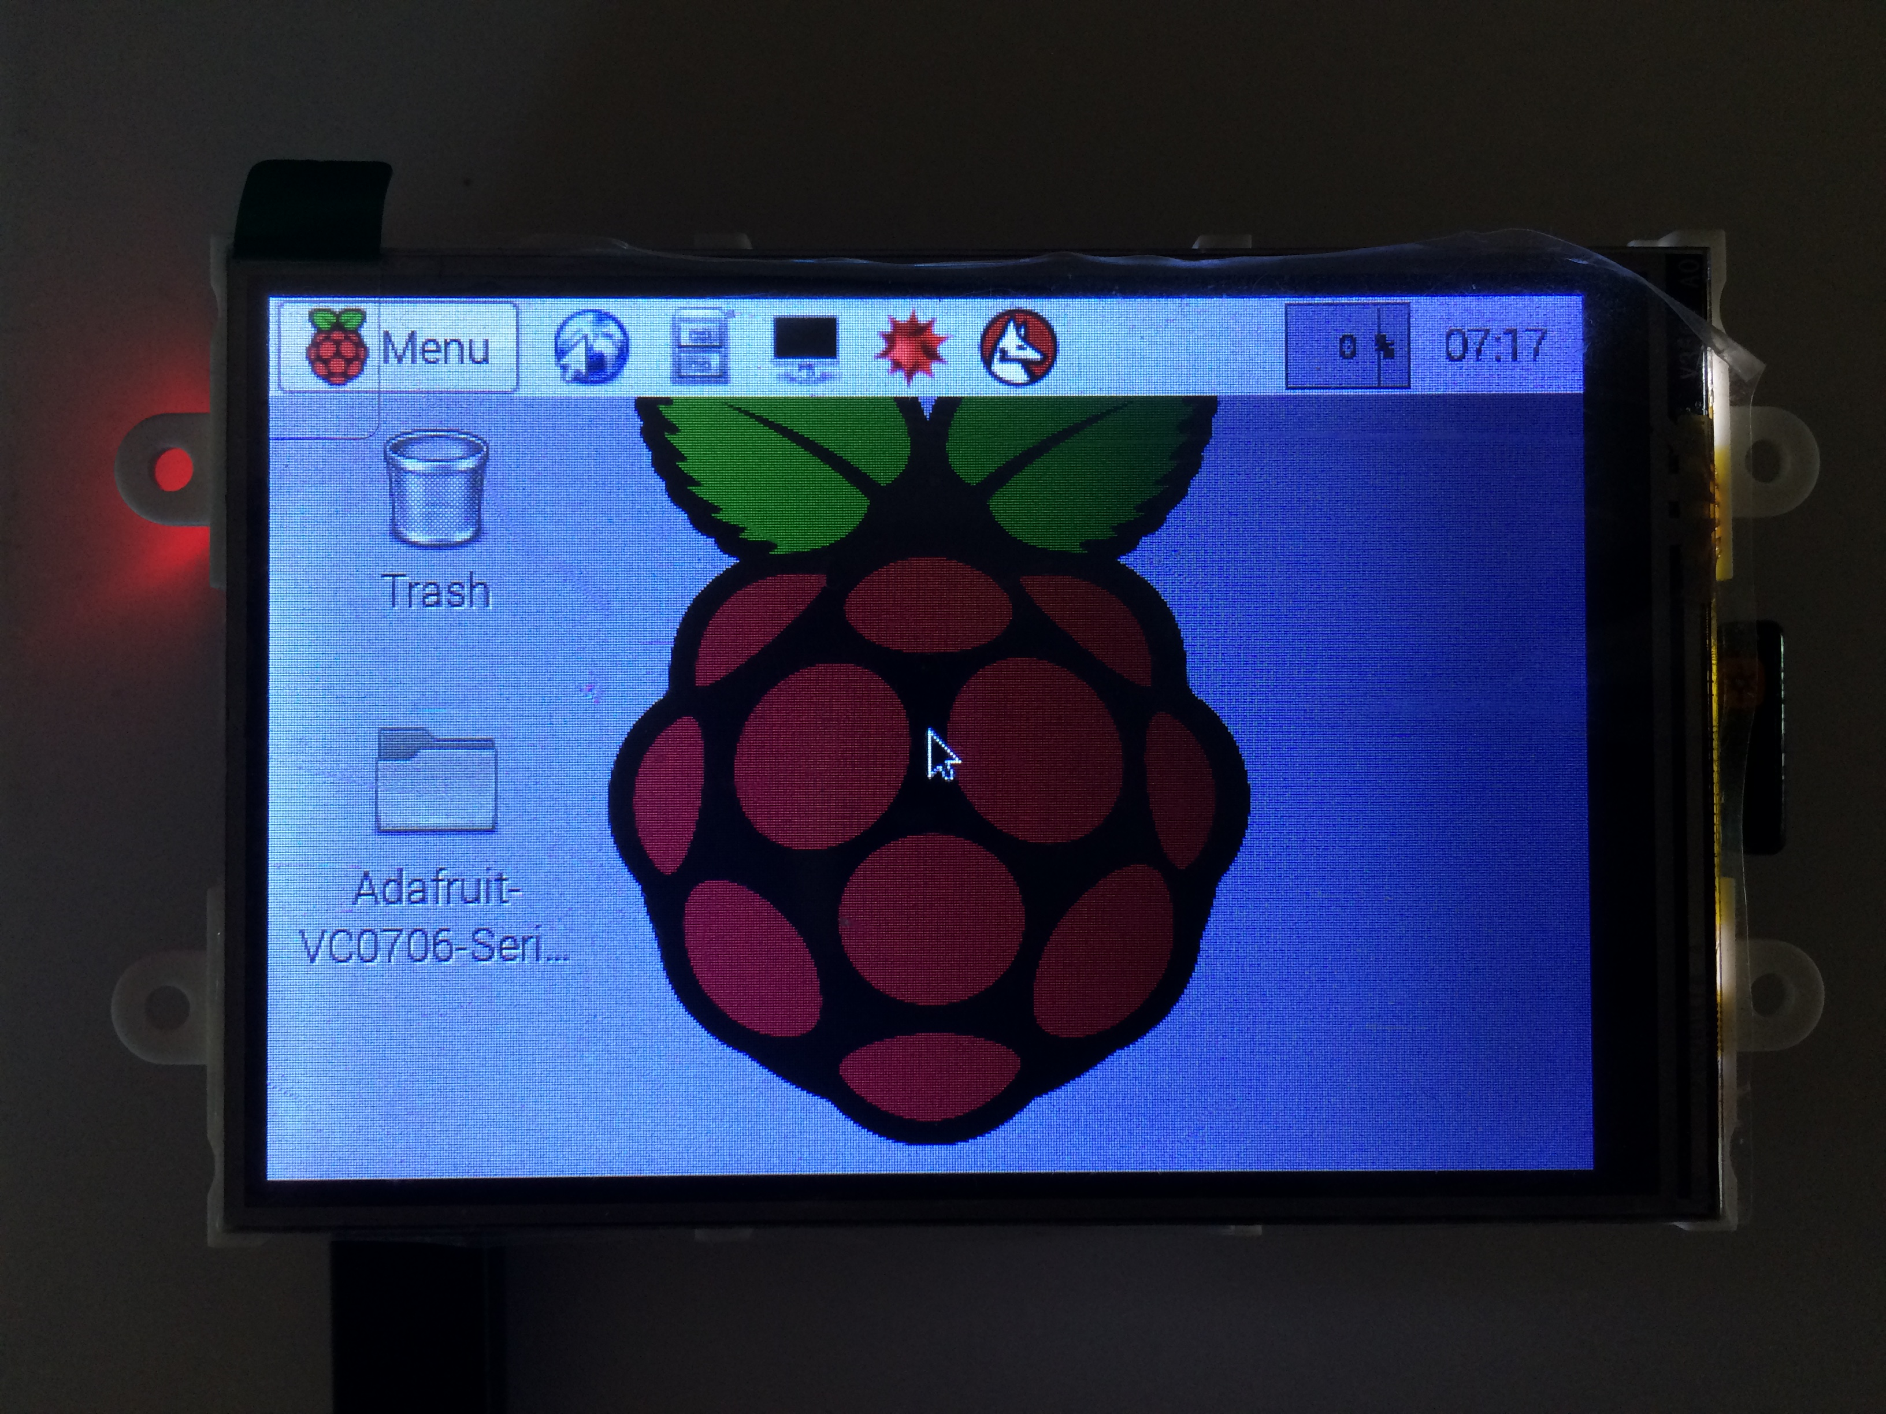
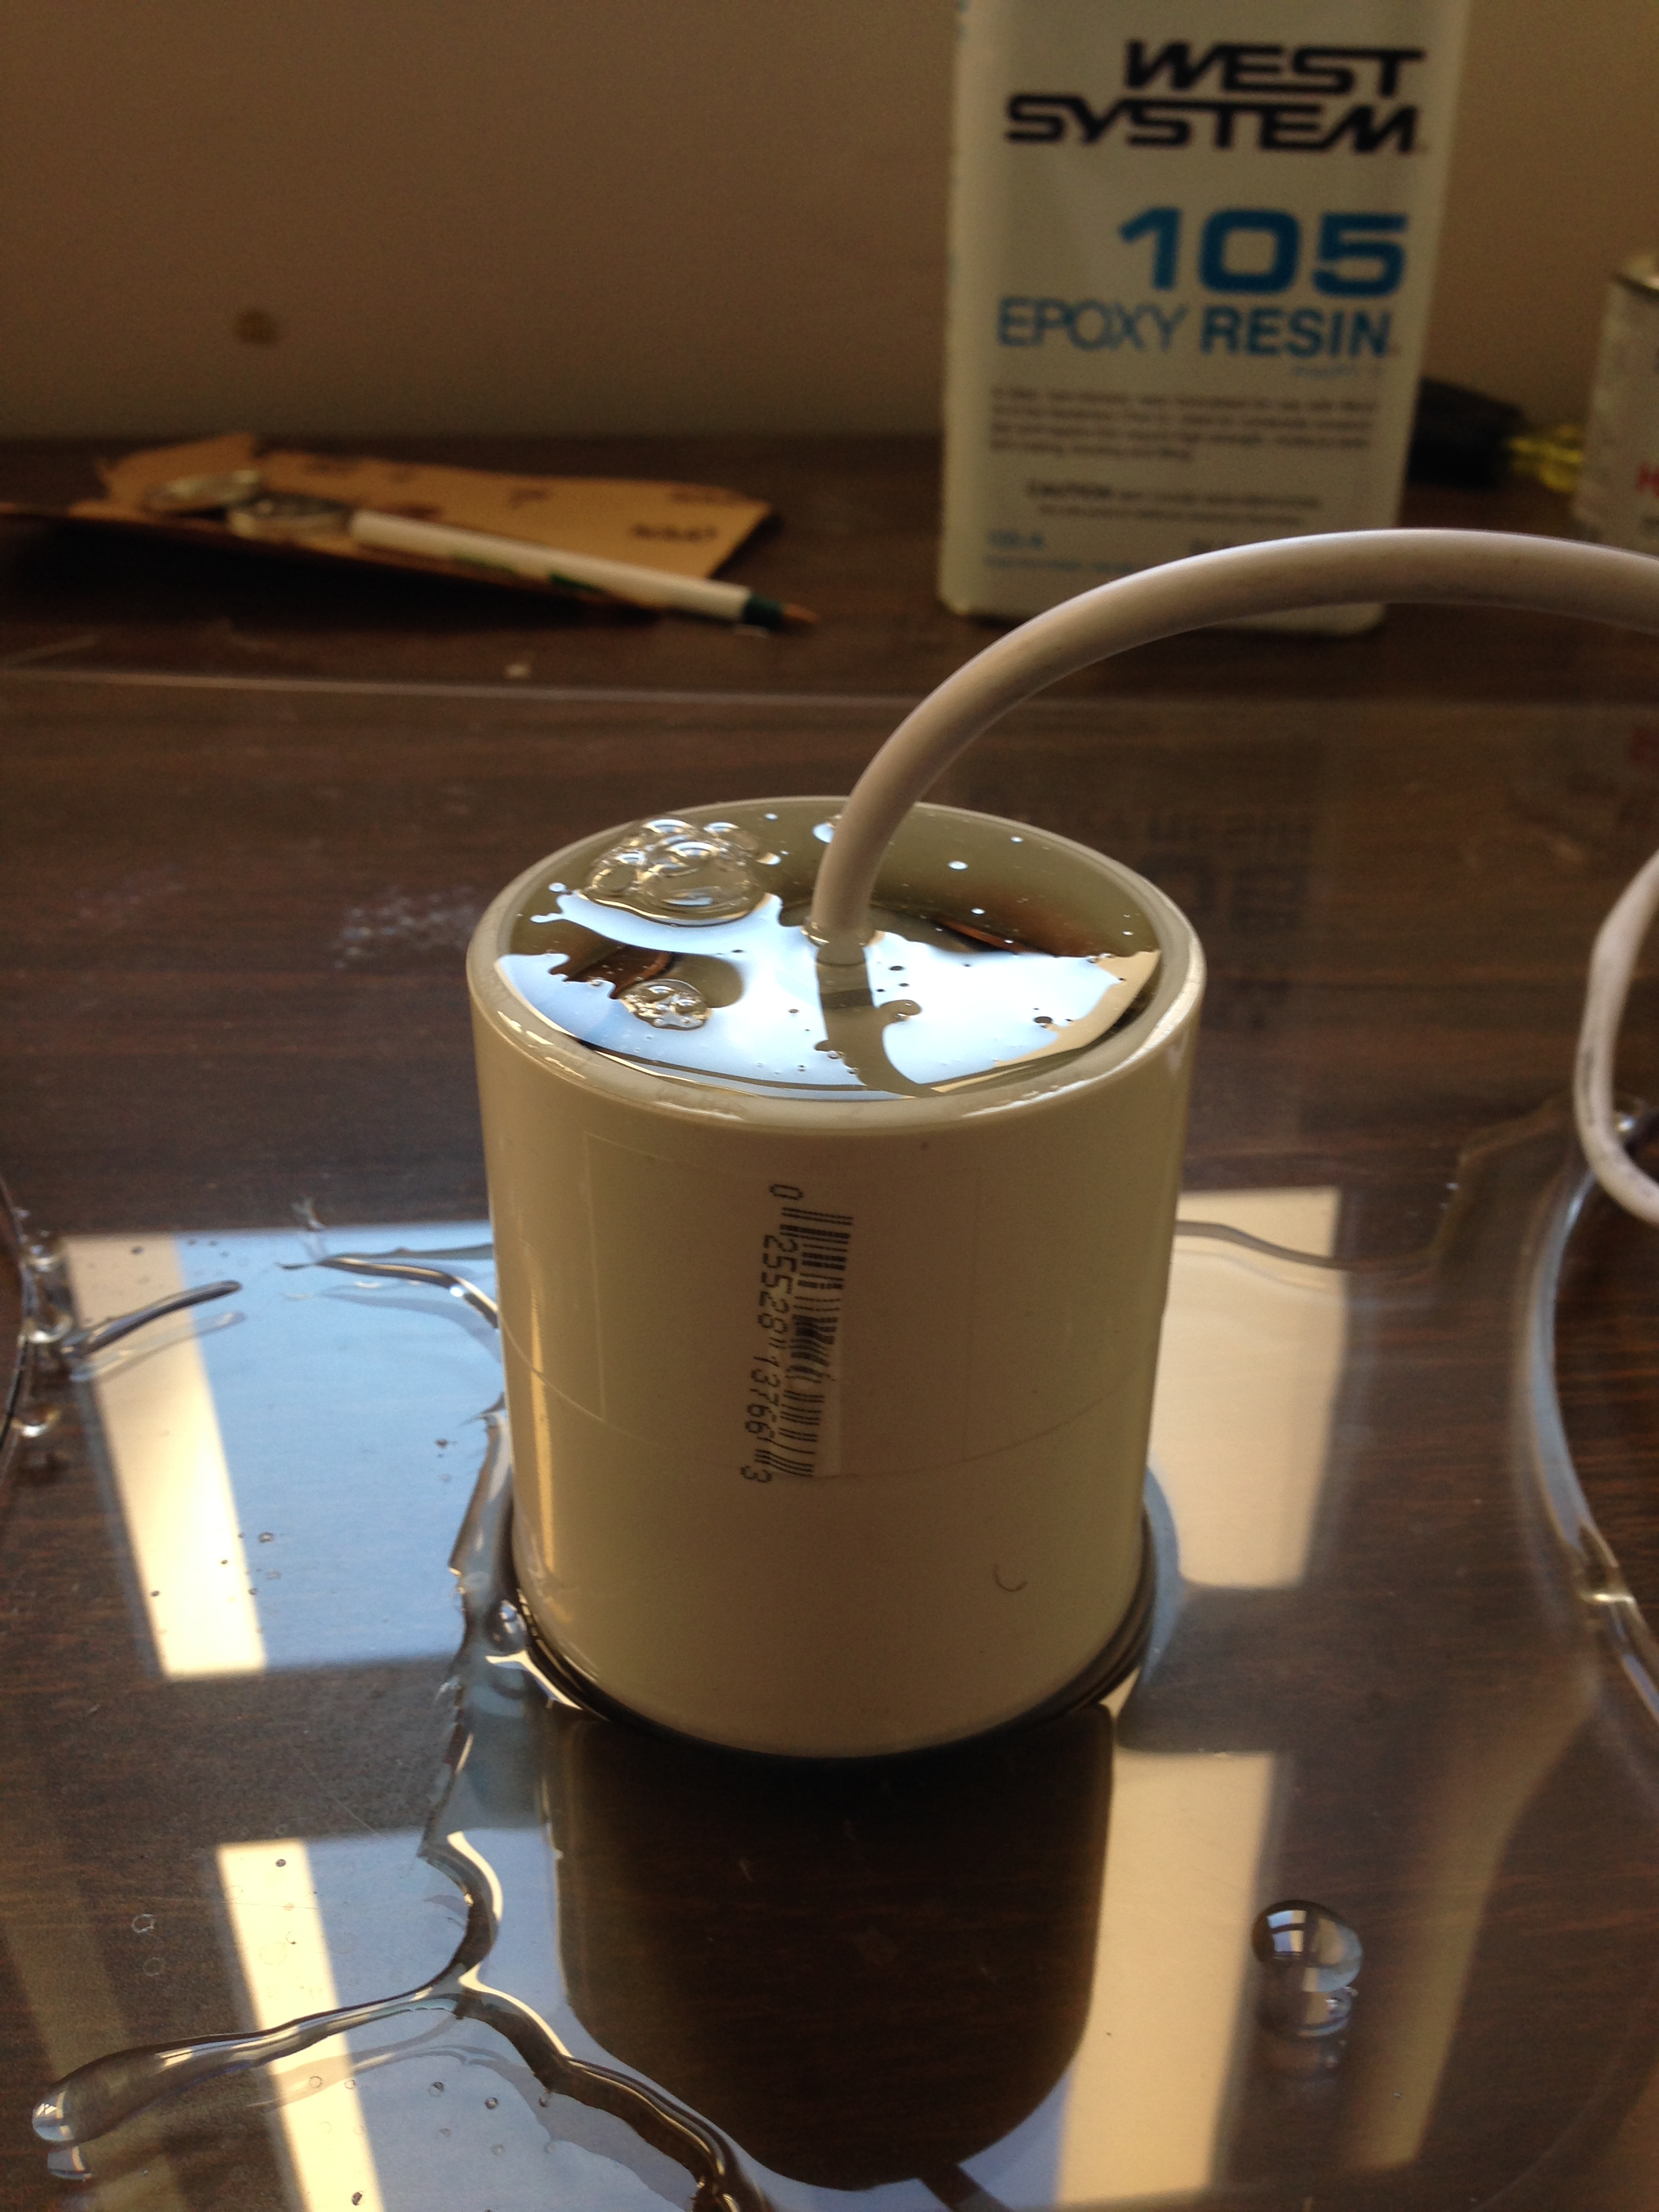
Lobsters
Display
Received Display
Installed requisite OS
Configured Monitor
Determined through testing
External Monitor cannot be used at the same time (No HDMI parallel)
Pi cannot support monitor and camera simultaneously (we had suspected this but figured we would try it anyways)
Waterproofing
Encased camera in Epoxy and shelled exterior with lycra lens cover. Initial rough cut complete, final cuts are being performed tonight
Code
Code enhanced to increase functionality to end user and provide more in depth debugging data as we prepare to go into wireless data transfer

